Slide 1

TITANIC DATASET SURVIVAL PREDICTION USING LOGISTIC REGRESSION
By
TARUN GUPTA
(MCA 2nd Year, Enrollment No.:12022007017011)
Under the Supervision of
Prof. SUMAN ACHARYA
Dept. of Computer Applications
University of Engineering & Management, Jaipur

Slide 2
Outlines
Introduction
Literature Review
Objectives
Proposed Model
Experimental Setup
Result Analysis
Conclusion & Future Scope
Reference
Acknowledgement

Slide 3
Introduction
This project is a data analysis and machine learning project that aims to predict the survival of a person using a dataset that contains various details of passengers travelling in titanic ship. The project involves data cleaning, exploration, visualization, feature selection, and model training using the Logistic Regression algorithm. Feature selection is performed by dropping the irrelevant columns , and the final model is evaluated using the algorithm. The project uses Python libraries such as Pandas, Scikit-Learn, Seaborn, and Matplotlib.

Slide 4
Literature Review
Previous studies have explored survival prediction on historical datasets, such as the Titanic dataset. Logistic regression is a commonly used method for binary classification tasks. Literature suggests that factors like age, gender, and passenger class may influence survival rates. This study builds upon existing research to provide further insights.

Slide 5
Objectives
1. Analyze the distribution of survival outcomes in the Titanic dataset.
2. Explore the relationship between age and passenger class.
3. Engineer new features, such as the 'Family' feature, to enhance model performance.
4. Build a logistic regression model to predict survival based on available features.
5. Evaluate the model's performance using accuracy, precision, and F1 score metrics.

Slide 6
Proposed Model
1. Data Loading and Exploration:
The dataset is loaded using the Pandas library, and the first 11 rows are displayed to get an initial overview.
The count of passengers who survived or did not survive is calculated and visualized using a bar plot.
2. Data Analysis and Visualization:
A scatter plot is created to visualize the relationship between age and survival.
A Heatmap is created to visualize the correlation matrix.
3. Data Cleaning and Feature Engineering:
The “Ticket” and “Cabin” columns are dropped from the dataset.
A new feature 'Family' is created by summing the “SibSp” (siblings/spouses) and “Parch” (parents/children) columns.
The “SibSp” and “Parch” columns are then dropped from the dataset.
Label encoding is applied to the “Sex” and “Embarked” columns.
Missing values in the dataset are filled with the median values.
Model Building and Model Evaluation:
The dataset is split into features (x) and the target variable (y).
The 'train_test_split' function from Scikit-learn is used to split the data into training and testing sets.
A logistic regression model is instantiated and trained using the training data.
The accuracy, precision, and F1 score of the model are calculated using the testing set.

Slide 7
Experimental Set-up
System requirements: Windows 11
Language : python 3
Algorithm : Logistic Regression , python libraries and imports
Platform : JUPYTER NOTEBOOK

Slide 8
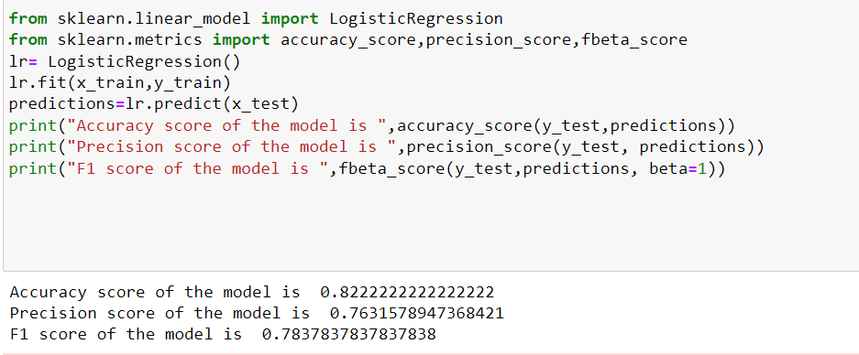
Result Analysis
The output we are expecting is coming.
Result analysis is the major supervised step for analysis to the expected output of our project.
By using python 3, Logistic Regression, libraries, imports we provided good design and the expected output .The model gave an accuracy of 82%.
Figure: Accuracy of the Model

Slide 9
Limitation
The dataset used for training and testing the model may be limited in size.
The code uses “drop” function in pandas library to perform feature selection, which may not always be the best method for selecting relevant features.
The accuracy of the model is 82% so for some test data it might not give accurate results.

Slide 10
Conclusions & Future Scope
The code currently focuses on Titanic Survival prediction, and the developed model can potentially predict the survival state of majority of the passengers travelling in titanic ship.
We can Customize dataset like we add more data of people.
The code currently uses a basic set of features for classification. Future work could involve exploring additional relevant features, and scaling techniques and implementing other machine learning algorithms to improve the model's accuracy and predictive power.

Slide 11
References
1. https://www.kaggle.com/
2. https://towardsdatascience.com/logistic-regression-detailed-overview-46c4da4303bc
3. https://youtu.be/ehO0-6i9qD4?list=PLKnIA16_Rmvbr7zKYQuBfsVkjoLcJgxHH

Slide 12
Acknowledgement
Firstly We would like to thank to our teacher, our friends and other sources that gave us an unending support, courage and helped us in numerous ways.
We would like to thank our family members for their whole hearted support .
We duly acknowledge the contribution of Santanu Basak for invaluable help.

Slide 13


